Slide 1

Briefing
2017-07-27

Slide 2



Daily meteorological forecast
34th WGC, Pociūnai
2

Slide 3
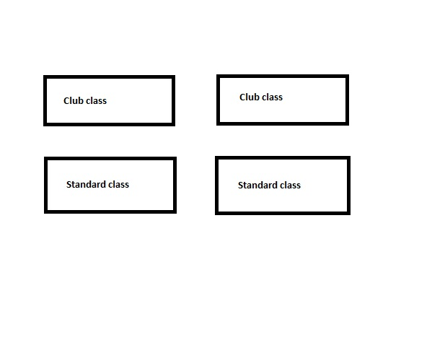
Grid (07-27)

Slide 4
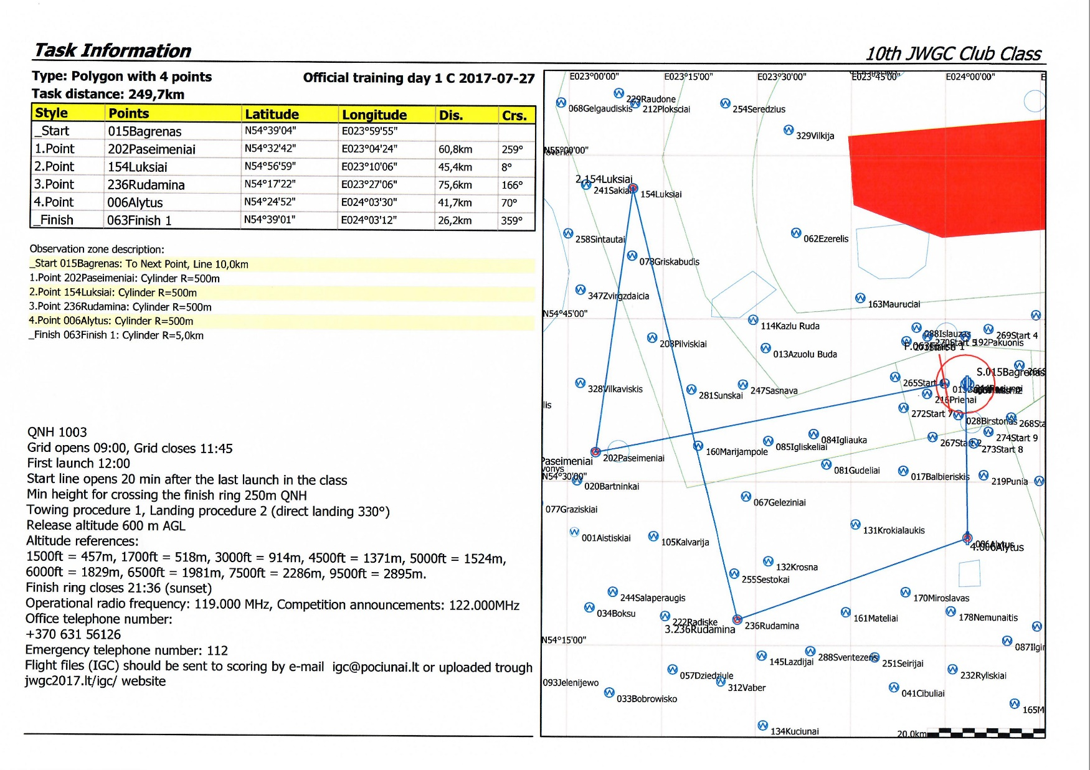
Task

Slide 5
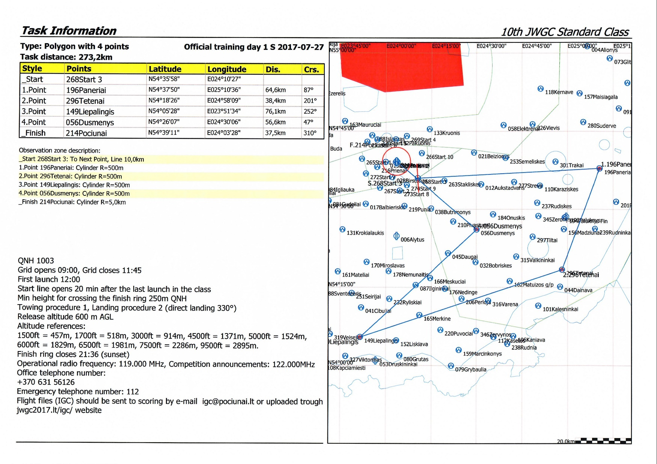
Task

Slide 6
Tracking
Tracking system from Flarms
Tracking can be found at the new site:
http://jwgc.onglide.com
Only identified glider flarms will be seen
Identification of Flarms at:
http://ddb.glidernet.org/

Slide 7
Technical control
07-27
09:00 – 12:00
13:00 – 18:00

Slide 8
Flight record handling
Flight records should be sent to e-mail igc@pociunai,lt after flight. Upload from competition website also is possible.
Scoring e-mail (for a response): scoring@pociunai.lt

Slide 9
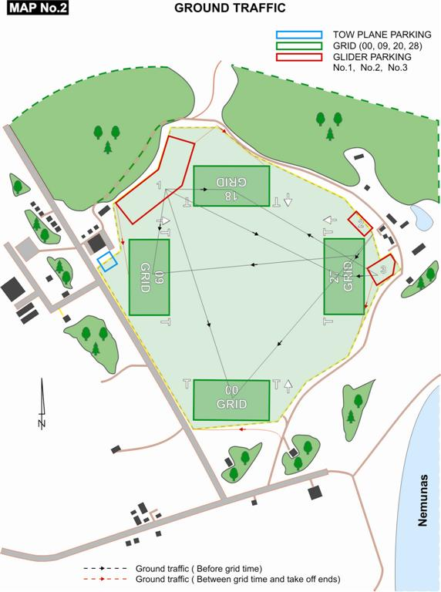
Procedures

Slide 10
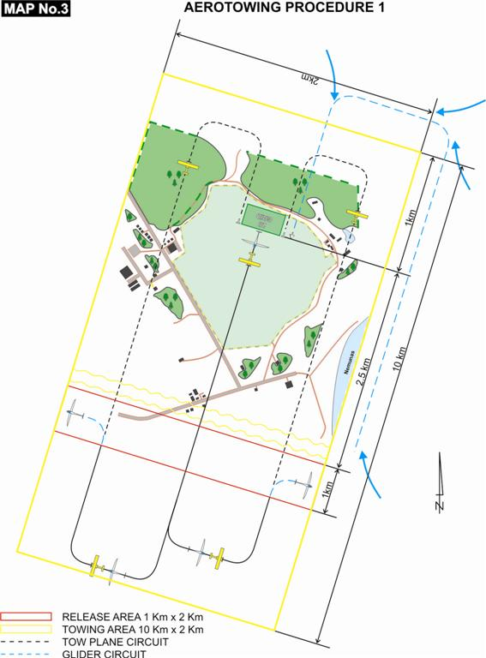
Procedures

Slide 11
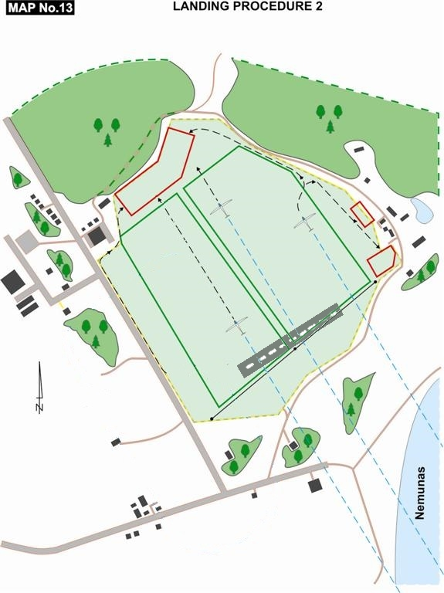
Procedures

